Slide 1
Information Gathering: Unobtrusive Methods
5
Systems Analysis and Design, 8e
Kendall & Kendall

Slide 2
Learning Objectives
Recognize the value of unobtrusive methods for information gathering.
Understand the concept of sampling for human information requirements analysis.
Construct useful samples of people, documents, and events for determining human information requirements.
Create an analyst’s playscript to observe decision-maker activities.
Apply the STROBE technique to observe and interpret the decision-maker’s environment and their interaction with technologies.
Kendall & Kendal Copyright © 2011 Pearson Education, Inc. Publishing as Prentice Hall
5-<number>

Slide 3
Unobtrusive Methods
Less disruptive
Insufficient when used alone
Multiple methods approach
Used in conjunction with interactive methods
Kendall & Kendal Copyright © 2011 Pearson Education, Inc. Publishing as Prentice Hall
5-<number>
Notes:
Unobtrusive methods:
sampling
investigation
observing
Multiple methods approach – using unobtrusive methods in conjunction with interactive methods.
Using both interactive and unobtrusive methods will result in a more complete picture of human information requirements.

Slide 4
Major Topics
Sampling
Quantitative document analysis
Qualitative document analysis
Observation
STROBE
Applying STROBE
Kendall & Kendal Copyright © 2011 Pearson Education, Inc. Publishing as Prentice Hall
5-<number>

Slide 5
Sampling
A process of systematically selecting representative elements of a population
Involves two key decisions:
  What to examine
  Which people to consider
Kendall & Kendal Copyright © 2011 Pearson Education, Inc. Publishing as Prentice Hall
5-<number>
Notes:
By selecting a representative population the analyst can reveal useful information about the population as a whole.
What to examine – there are many reports, forms, output documents, memos, and web sites that have been generated by people in the organization
Which people to consider – which people should be selected to represent the population as a whole?

Slide 6
Need for Sampling
The reasons systems analysts do sampling are:
  Containing costs
  Speeding up the data gathering
  Improving effectiveness
  Reducing bias
Kendall & Kendal Copyright © 2011 Pearson Education, Inc. Publishing as Prentice Hall
5-<number>
Notes:
Containing costs:
examining every document, talking to everyone, and reading every web page would be to costly.
employee time, copying reports and duplicating unnecessary reports would be an added expense
Speeding up the data gathering – sampling speeds up the process by examining a smaller population which in turn reduces the amount of data that needs to be analyzed.
Improving effectiveness – by examining a sample of the population more detailed questions can be answered and followed up on thus improving the effectiveness of data gathering
Reducing bias -

Slide 7
Sampling Design
To design a good sample, a systems analyst must follow four steps:
  Determining the data to be collected or described
  Determining the population to be sampled
  Choosing the type of sample
  Deciding on the sample size
Kendall & Kendal Copyright © 2011 Pearson Education, Inc. Publishing as Prentice Hall
5-<number>
Notes:
Determining the data to be collected or described – if irrelevant data are gathered, then time and money are wasted in the collection, storage, and analysis of useless data.
Determining the population to be sampled – must determine what the population is
Choosing the type of sample – There are four type of samples; convenience, purposive, simple, and complex.
convenience samples – unrestricted, nonprobability samples, easiest to arrange but also the most unreliable
purposive samples – based on judgment, moderately reliable
simple – need a numbered list of the population to ensure an equal chance of being selected, often not practical
complex random samples –
systematic – example might be to select every kth person
stratified – process of identifying subpopulations, or strata, and then selecting from these subpopulations
cluster – select a group representative of all the groups of that type
Deciding on the sample size – needs to be greater then 1 but less than the size of the population itself. The absolute number is more important then the percentage of the population.

Slide 8
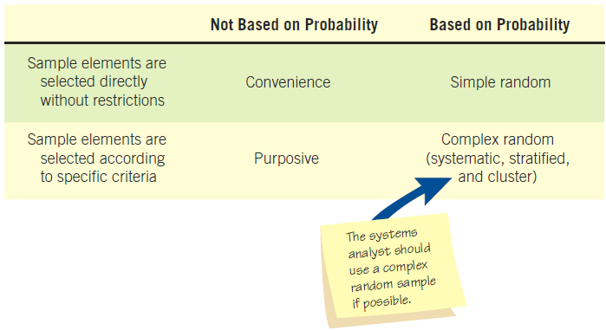
Four Main Types of Samples the Analyst Has Available (Figure 5.1)
Kendall & Kendal Copyright © 2011 Pearson Education, Inc. Publishing as Prentice Hall
5-<number>

Slide 9
The Sample Size Decision
Determine the attribute.
Locate the database or reports in which the attribute can be found.
Examine the attribute.
Make the subjective decision regarding the acceptable interval estimate.
Choose the confidence level.
Calculate the standard error.
Determine the sample size.
Kendall & Kendal Copyright © 2011 Pearson Education, Inc. Publishing as Prentice Hall
5-<number>
Notes:
The sample size often depends on the cost involved or the time required by the systems analysts, or even the time available by people in the organization.
Determine the attribute – determine the attribute to sample.
Locate the database or reports in which the attribute can be found – find out where the data is stored; database, on a form, or in a report.
Examine the attribute – estimate ρ, the proportion of the population having the attribute. A value of .10 generally results in an acceptable sample size.
Make the subjective decision regarding the acceptable interval estimate – this is purely a subjective decision. An interval estimate (i) of ± .10 means an error of no more than 0.10 in either direction from the actual proportion, ρ.
Choose the confidence level – the desired degree of certainty and then look up the confidence coefficient level (z value) in a table.

Slide 10
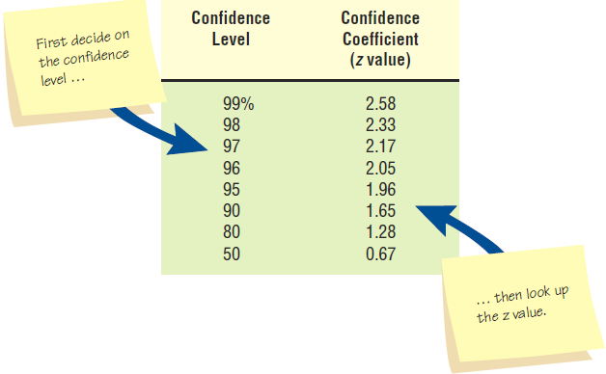
A Table of Area under a Normal Curve Can Be Used to Look up a Value Once the Systems Analyst Decides on the Confidence Level (Figure 5.2)
Kendall & Kendal Copyright © 2011 Pearson Education, Inc. Publishing as Prentice Hall
5-<number>
Notes:
The choice of the confidence level is purely subjective. It is the desired degree of certainty.

Slide 11
Calculate the Standard Error of the Proportion
σ_{p} = i/z
i = interval estimate
z = confidence coefficient found in the confidence level lookup table
Kendall & Kendal Copyright © 2011 Pearson Education, Inc. Publishing as Prentice Hall
5-<number>

Slide 12
Determine the Sample Size
  σ_{p} = standard error
  ρ = the proportion of the population having the attribute
p(1-p)
n = + 1
σ_{p}²
Kendall & Kendal Copyright © 2011 Pearson Education, Inc. Publishing as Prentice Hall
5-<number>

Slide 13
Example: A. Sembly Company
Determine that you are looking for orders with mistakes .
Locate order forms from the past six months.
Examine order forms and conclude that p=5%.
Subjective decision of acceptable interval i = ± 0.02
Look up confidence coefficient z-value = 1.96.
Calculate σ_{p} = i / z = 0.02/1.96 = 0.0102.
Determine n; n = 458.
Kendall & Kendal Copyright © 2011 Pearson Education, Inc. Publishing as Prentice Hall
5-<number>
Notes:
The higher the confidence level the larger the sample size. If we increase the confidence level from 95% to 99% the sample size would increase from 458 to 1827.

Slide 14
Investigation
The act of discovery and analysis of data
Hard data
  Quantitative
  Qualitative
Kendall & Kendal Copyright © 2011 Pearson Education, Inc. Publishing as Prentice Hall
5-<number>
Notes:
Hard data reveal where the organization has been and where its members believe it is going.

Slide 15
Analyzing Quantitative Documents
Reports used for decision making
Performance reports
Records
Data capture forms
Ecommerce and other transactions
Kendall & Kendal Copyright © 2011 Pearson Education, Inc. Publishing as Prentice Hall
5-<number>
Notes:
All these documents have a specific purpose and audience for which they are targeted.

Slide 16
Reports Used for Decision Making
Sales reports
Production reports
Summary reports
Kendall & Kendal Copyright © 2011 Pearson Education, Inc. Publishing as Prentice Hall
5-<number>
Notes:
Sales reports – summarize the amount sold and the type of sales. They might include graphical output comparing revenue and income over a set number of periods.
Production reports – include recent costs, current inventory, recent labor, and plant information.
Summary reports – provide background information, spot exceptions to normal occurrences, and afford strategic overviews of organizational plans.

Slide 17
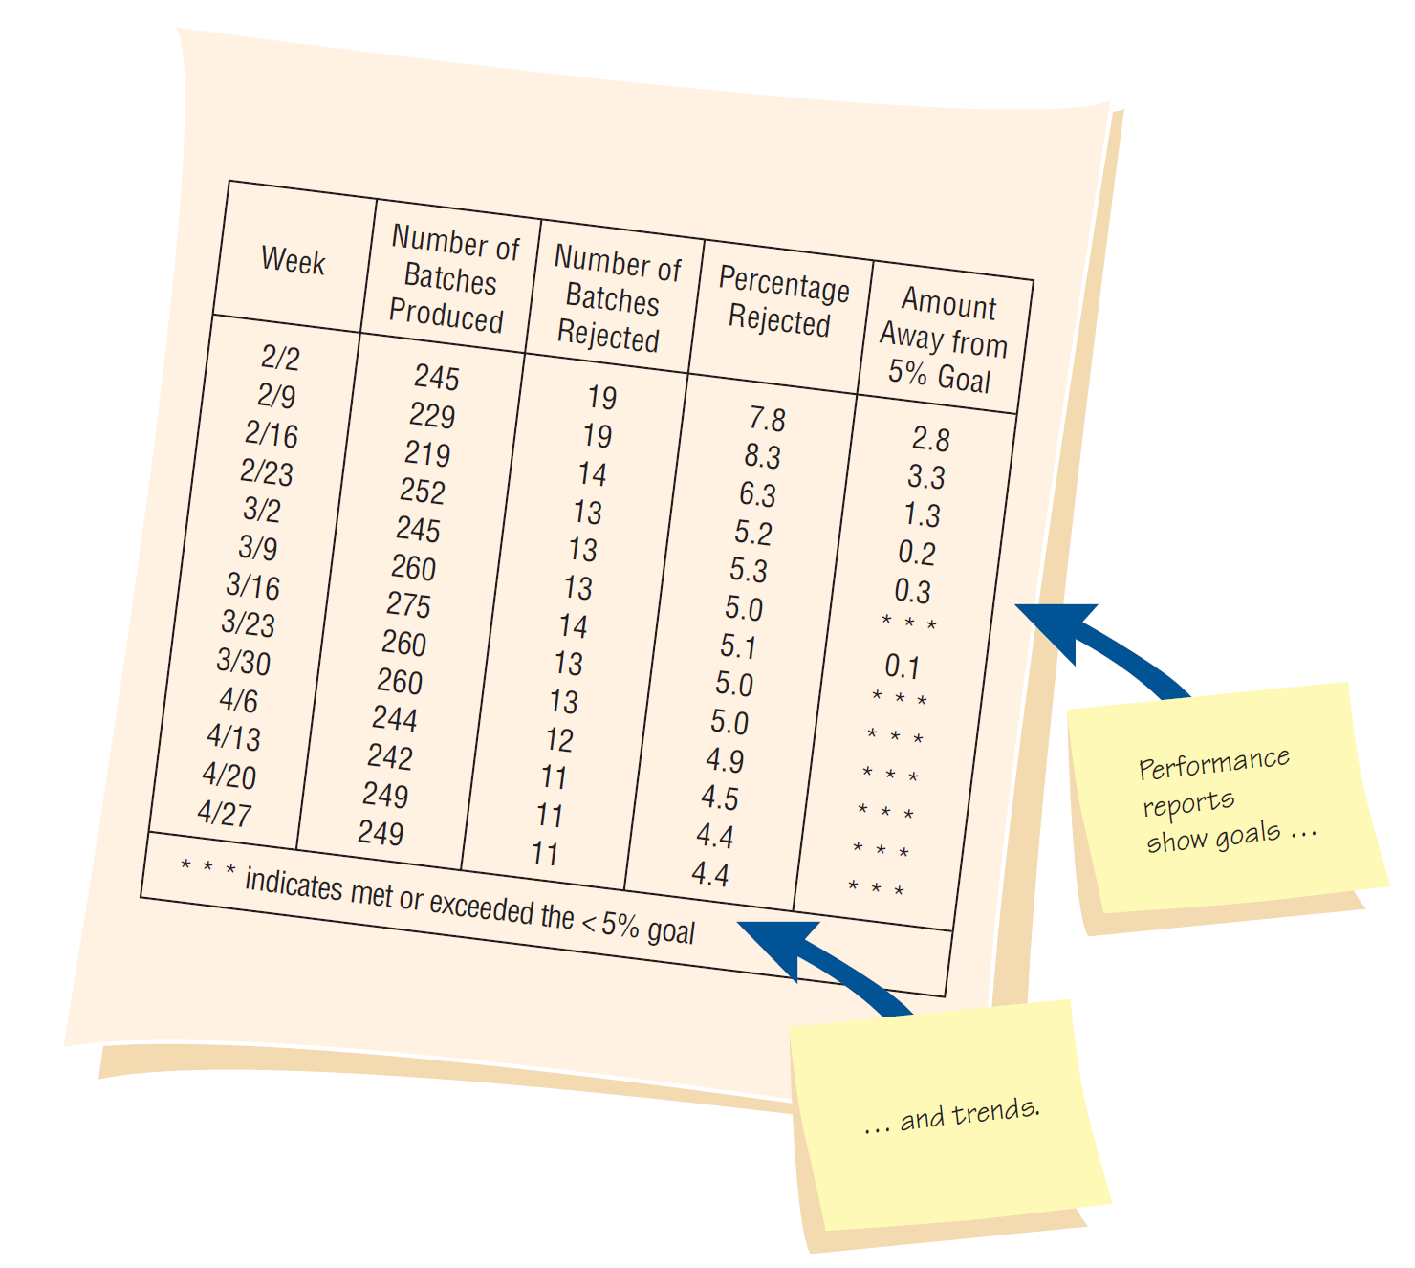
A Performance Report Showing Improvement (Figure 5.3)
Kendall & Kendal Copyright © 2011 Pearson Education, Inc. Publishing as Prentice Hall
5-<number>

Slide 18
A Manually Completed Payment Record (Figure 5.4)
Kendall & Kendal Copyright © 2011 Pearson Education, Inc. Publishing as Prentice Hall
5-<number>
Notes:
Ways to inspect a record
Checking for errors in amounts and totals
Looking for opportunities for improving the recording form design
Observing the number and type of transaction
Watching for instances in which the computer can simplify the work.

Slide 19
Data Capture Forms
Collect examples of all the forms in use.
Note the type of form.
Document the intended distribution pattern.
Compare the intended distribution pattern with who actually receives the form.
Kendall & Kendal Copyright © 2011 Pearson Education, Inc. Publishing as Prentice Hall
5-<number>
Notes:
Blank forms can be compared with filled-in forms to:
see if any data items are consistently left blank
see if the people who are supposed to receive the forms actually do
see if standard procedures for using, storing, and discarding them are followed

Slide 20
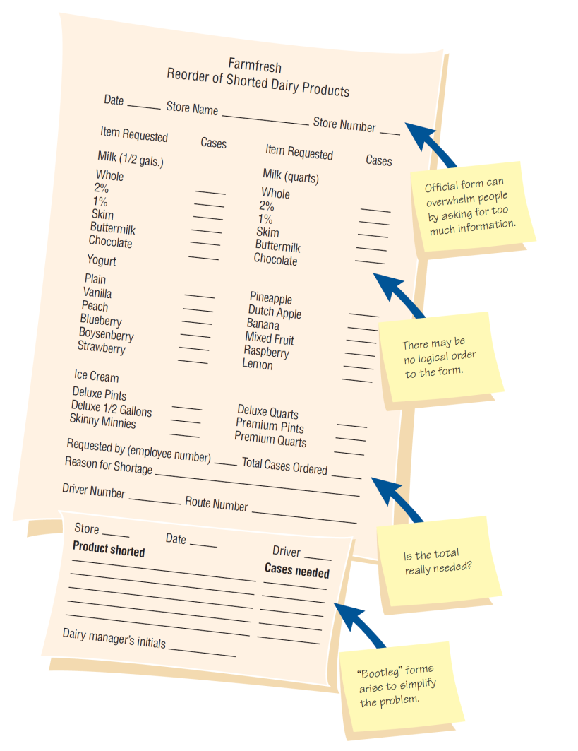
Questions to Ask about Official and Bootleg Forms that Are Already Filled out (Figure 5.5)
Kendall & Kendal Copyright © 2011 Pearson Education, Inc. Publishing as Prentice Hall
5-<number>
Notes:
Is the form filled out in its entirety?
Are there forms that are never used? Why?
Are all copies of forms circulated to the proper people or filled appropriately? If not, why not?
If there is a paper form that is offered as an alternative to a Web-based form, compare the completion rates for both.
Are “unofficial” forms used o a regular basis?

Slide 21
Analyzing Qualitative Documents
Key or guiding metaphors
Insiders vs. outsiders mentality
What is considered good vs. evil
Graphics, logos, and icons in common areas or Web pages
A sense of humor
Kendall & Kendal Copyright © 2011 Pearson Education, Inc. Publishing as Prentice Hall
5-<number>
Notes:
Includes email messages, memos, signs on bulletin boards and in the work areas, Web pages, procedure manuals, and policy handbooks.

Slide 22
Analyzing Qualitative Documents
Email messages and memos
Signs or posters on bulletin boards
Corporate Web sites
Manuals
Policy handbooks
Kendall & Kendal Copyright © 2011 Pearson Education, Inc. Publishing as Prentice Hall
5-<number>
Notes:
Corporate Web sites – examine the contents for metaphors, humor, use of design features and the meaning and clarity of any messages provided.
Manuals – present the “idea,” the way machines and people are expected to behave.
Policy Handbooks – allows the systems analyst to gain an awareness o the values, attitudes, and beliefs guiding the company.

Slide 23

Analysis of Memos Provides Insight into the Metaphors that Guide the Organization’s Thinking (Figure 5.6)
Kendall & Kendal Copyright © 2011 Pearson Education, Inc. Publishing as Prentice Hall
5-<number>
Notes:
Memos reveal a lively, continuing dialogue in the organization.

Slide 24
Observation
Observation provides insight on what organizational members actually do.
See firsthand the relationships that exist between decision makers and other organizational members
Can also reveal important clues regarding HCI concerns
Kendall & Kendal Copyright © 2011 Pearson Education, Inc. Publishing as Prentice Hall
5-<number>
Notes:
Observing the decision maker; and the decision maker’s physical environment; and their interaction with their physical, ergonomic environment are important unobtrusive methods.

Slide 25
Analyst’s Playscript
Involves observing the decision-makers behavior and recording their actions using a series of action verbs
Examples:
  Talking
  Sampling
  Corresponding
  Deciding
Kendall & Kendal Copyright © 2011 Pearson Education, Inc. Publishing as Prentice Hall
5-<number>
Notes:
Observation allows the analyst to see firsthand how managers gather, process, share, and use information and technology to get work done.

Slide 26
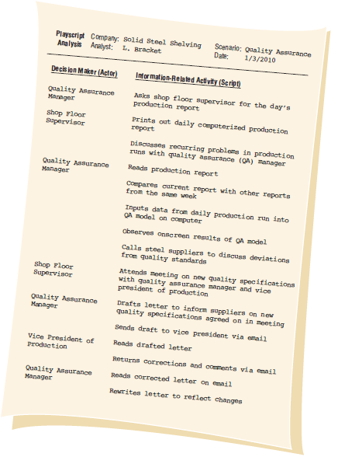
A Sample Page from the Analyst’s Playscript Describing Decision Making (Figure 5.7)
Kendall & Kendal Copyright © 2011 Pearson Education, Inc. Publishing as Prentice Hall
5-<number>

Slide 27
STROBE
STRuctured OBservation of the Environment—a technique for observing the decision-maker’s physical environment
Kendall & Kendal Copyright © 2011 Pearson Education, Inc. Publishing as Prentice Hall
5-<number>
Notes:
Observing the physical environment also reveals much about decision makers human information requirements.

Slide 28
STROBE Elements
Office location
Desk placement
Stationary equipment
Props
External information sources
Office lighting and color
Clothing worn by decision makers
Kendall & Kendal Copyright © 2011 Pearson Education, Inc. Publishing as Prentice Hall
5-<number>
Notes:
These elements can reveal much about the way a decision maker gathers, processes, stores, and shares information, as well as about the decision maker’s credibility in the workplace.

Slide 29
Office Location
Accessible offices
  Main corridors, open door
  Major traffic flow area
  Increase interaction frequency and informal messages
Inaccessible offices
  May view the organization differently
  Drift apart from others in objectives
Kendall & Kendal Copyright © 2011 Pearson Education, Inc. Publishing as Prentice Hall
5-<number>

Slide 30
Desk Placement
Visitors in a tight space, back to wall, large expanse behind desk
  Indicates maximum power position
Desk facing the wall, chair at side
  Encourages participation
  Equal exchanges
Kendall & Kendal Copyright © 2011 Pearson Education, Inc. Publishing as Prentice Hall
5-<number>

Slide 31
Stationary Office Equipment
File cabinets and bookshelves:
If not present, person stores few items of information personally
If an abundance, person stores and values information
Kendall & Kendal Copyright © 2011 Pearson Education, Inc. Publishing as Prentice Hall
5-<number>

Slide 32
Props
Calculators
Personal computers
Pens, pencils, and rulers
If present, person processes data personally
Kendall & Kendal Copyright © 2011 Pearson Education, Inc. Publishing as Prentice Hall
5-<number>

Slide 33
External Information Sources
Trade journals or newspapers indicate the person values outside information.
Company reports, memos, and policy handbooks indicate the person values internal information.
Kendall & Kendal Copyright © 2011 Pearson Education, Inc. Publishing as Prentice Hall
5-<number>

Slide 34
Office Lighting and Color
Warm, incandescent lighting indicates:
  A tendency toward more personal communication
  More informal communication
Brightly lit, bright colors indicate:
  More formal communications (memos, reports)
Kendall & Kendal Copyright © 2011 Pearson Education, Inc. Publishing as Prentice Hall
5-<number>

Slide 35
Clothing
Male
  Formal two-piece suit—maximum authority
  Casual dressing (sport jacket/slacks)—more participative decision making
Female
  Skirted suit—maximum authority
Kendall & Kendal Copyright © 2011 Pearson Education, Inc. Publishing as Prentice Hall
5-<number>

Slide 36
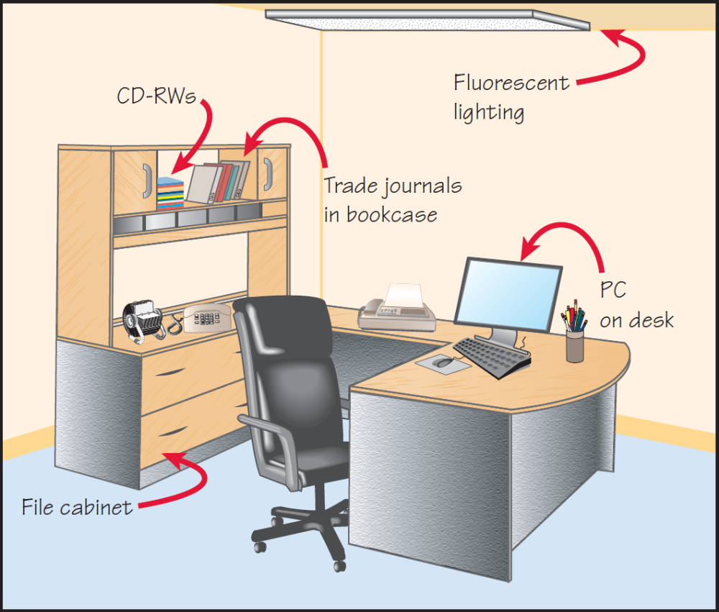
Observe a Decision Maker’s Office for Clues Concerning His or Her Personal Storage, Processing, and Sharing of Information (Figure 5.9)
Kendall & Kendal Copyright © 2011 Pearson Education, Inc. Publishing as Prentice Hall
5-<number>

Slide 37
Applying STROBE
The five symbols used to evaluate how observation of the elements of STROBE compared with interview results are:
  A checkmark means the narrative is confirmed.
  An “X” means the narrative is reversed.
  An oval or eye-shaped symbol serves as a cue to look further.
  A square means observation modifies the narrative.
  A circle means narrative is supplemented by observation.
Kendall & Kendal Copyright © 2011 Pearson Education, Inc. Publishing as Prentice Hall
5-<number>
Notes:
One way to implement STROBE is through the use of an anecdotal checklist with meaningful shorthand symbols.

Slide 38
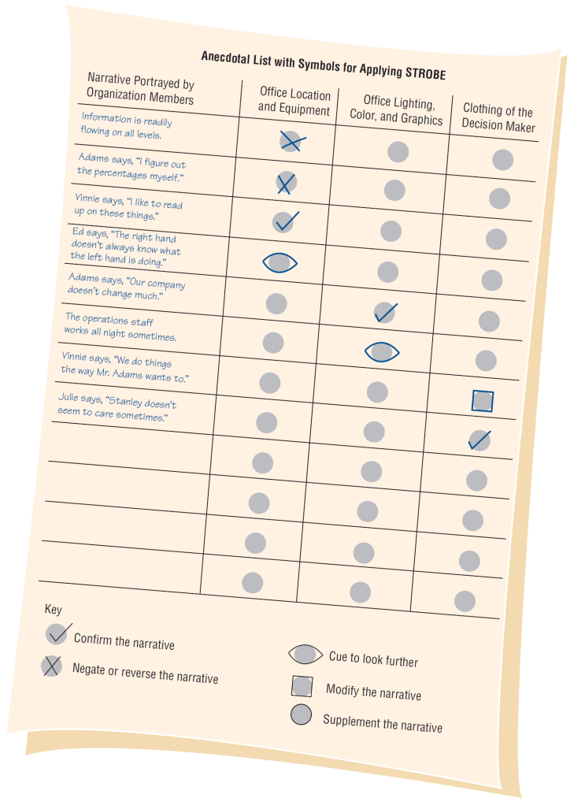
An Anecdotal List with Symbols for Use in Applying STROBE (Figure 5.11)
Kendall & Kendal Copyright © 2011 Pearson Education, Inc. Publishing as Prentice Hall
5-<number>

Slide 39
Summary
Sampling
  Designing a good sample
  Types of samples
  Sample size
Hard data
  Quantitative document analysis
  Qualitative document analysis
Observation
  Playscript
STROBE
  STROBE elements
  Applying STROBE
Kendall & Kendal Copyright © 2011 Pearson Education, Inc. Publishing as Prentice Hall
5-<number>

